Slide 1
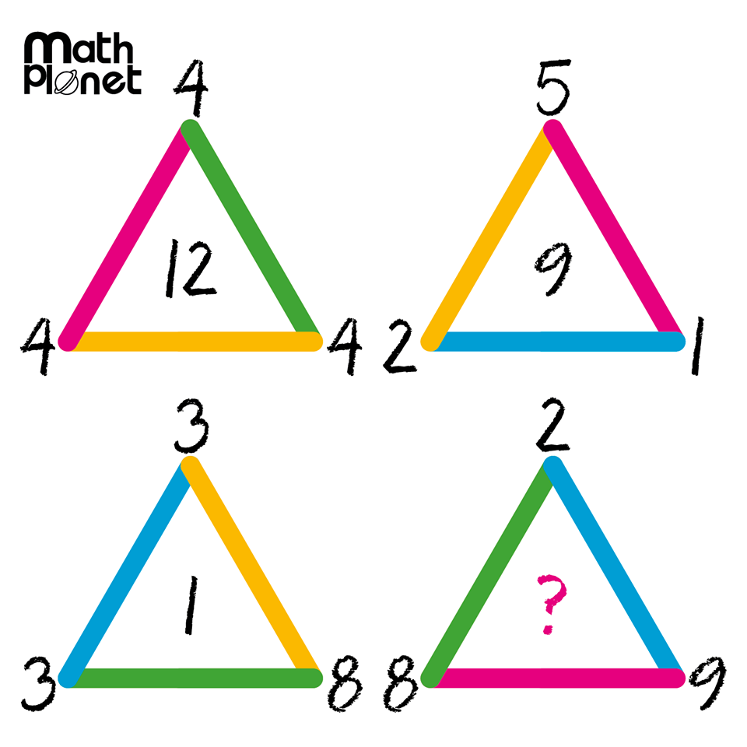
Warm Up

Slide 2
Balancing Equations
Ms. Latham

Slide 3
24
7
30
Date
Balancing Equations
EQ – How and why do we balance equations?
Why do we solve equations?
To find the value of the unknown, which is represented by a variable.
What is balancing equations?
Because the expressions are equal, we MUST do the same to both sides.
Opposite of :
Addition +
Subtraction -
Multiplication ×
Division ÷
-
+
÷
×
What are our opposite operations?

Slide 4
NLVM – National Library of Virtual Manipulatives
http://nlvm.usu.edu/

Slide 5
Pairs Practice!
You will need: 1 dry erase marker, 15 counters, sticky notes and a tissue
This is what you will be doing on your desks!
X+5=9
Imagine that the gap between the desks is the equal symbol!
X
+
=
Subtract 5 from both sides
- 5
- 5

Slide 6
Pairs Practice!
You will need: 1 dry erase marker, 15 counters, sticky notes and a tissue
Try these :
y + 4 = 6
b – 2 =8
a + 7 = 10
x + 6=9
y – 4 = 7
Extension:
Think about how you would solve these:
3x = 9
2x = 6
This is what you will be doing on your desks!
X+5=9
Imagine that the gap between the desks is the equal symbol!
X
+
=
Subtract 5 from both sides
- 5
- 5
X

Slide 7
Pairs Practice!
You will need: 1 dry erase marker, 15 counters, sticky notes and a tissue
Try these :
y + 4 = 6 y= 2
b – 2 =8 b = 10
a + 7 = 10 a = 3
x + 6 = 9 x = 3
y – 4 = 7 y = 11
Extension:
Think about how you would solve these:
3x = 9
2x = 6
This is what you will be doing on your desks!
X+5=9
Imagine that the gap between the desks is the equal symbol!
X
+
=
Subtract 5 from both sides
- 5
- 5
X

Slide 8
What about multiplication?
How would we solve these?
3x = 9
2x = 6
What undoes multiplication?
Notes:
Go back to the NLVM

Slide 9
Pairs Practice!
You will need: 1 dry erase marker, 15 counters, sticky notes and a tissue
This is what you will be doing on your desks!
÷
3x=9
What operation is sharing?
We have to share the 9 cubes between the 3 x’s
X
X
X
=
÷ 3
÷ 3
X

Slide 10
Pairs Practice!
You will need: 1 dry erase marker, 15 counters, sticky notes and a tissue
Try these :
4x = 12
3y = 15
2a = 14
Extension:
(you wont be able to do these with your counters)
8x = 20
4x = 24
This is what you will be doing on your desks!
÷
3x=9
What operation is sharing?
We have to share the 9 cubes between the 3 x’s
X
X
X
=
÷ 3
÷ 3
X

Slide 11
Pairs Practice!
You will need: 1 dry erase marker, 15 counters, sticky notes and a tissue
This is what you will be doing on your desks!
Try these :
4x = 12 x = 3
3y = 15 y = 5
2a = 14 a = 7
Extension:
(you wont be able to do these with your counters)
8x = 20
4x = 24
÷
3x=9
What operation is sharing?
We have to share the 9 cubes between the 3 x’s
X
X
X
=
÷ 3
÷ 3
X

